Slide 1
Method Overriding in Python
The Python method overriding refers to defining a method in a subclass with the same name as a method in its superclass. In this case, the Python interpreter determines which method to call at runtime based on the actual object being referred to. we can always override your parent class methods. One reason for overriding parent's methods is that you may want special or different functionality in your subclass.

Slide 2
Example
In the code below, we are overriding a method named myMethod of Parent class.
# define parent class class Parent: def myMethod(self): print ('Calling parent method')
# define child class class Child(Parent): def myMethod(self): print ('Calling child method')
# instance of child c = Child()
# child calls overridden method c.myMethod()
output −
Calling child method

Slide 3
class Employee:
def __init__(self,nm, sal):
self.name=nm
self.salary=sal
def getName(self):
return self.name
def getSalary(self):
return self.salary
class SalesOfficer(Employee):
def __init__(self,nm, sal, inc):
super().__init__(nm,sal)
self.incnt=inc
def getSalary(self):
return self.salary+self.incnt
e1=Employee("Rajesh", 9000)
print ("Total salary for {} is Rs {}".format(e1.getName(),e1.getSalary())) s1=SalesOfficer('Kiran', 10000, 1000)
print ("Total salary for {} is Rs {}".format(s1.getName(),s1.getSalary()))
output −
Total salary for Rajesh is Rs 9000 Total salary for Kiran is Rs 11000

Slide 4
Base Overridable Methods
The following table lists some generic functionality of the object class, which is the parent class for all Python classes. You can override these methods in your own class −
Sr.No | Method, Description & Sample Call
1 | __init__ ( self [,args...] ) Constructor (with any optional arguments) Sample Call : obj = className(args)
2 | __del__( self ) Destructor, deletes an object Sample Call : del obj
3 | __repr__( self ) Evaluatable string representation Sample Call : repr(obj)
4 | __str__( self ) Printable string representation Sample Call : str(obj)

Slide 5
Python - Method Overloading
Method overloading is a feature of object-oriented programming where a class can have multiple methods with the same name but different parameters. To overload method, we must change the number of parameters or the type of parameters, or both.
Method Overloading in Python
Unlike other programming languages like Java, C++, and C#, Python does not support the feature of method overloading by default. However, there are alternative ways to achieve it.
Example
If you define a method multiple times as shown in the below code, the last definition will override the previous ones. Therefore, this way of achieving method overloading in Python generates error.

Slide 6
class example:
def add(self, a, b):
x = a+b
return x
def add(self, a, b, c):
x = a+b+c
return x
obj = example()
print (obj.add(10,20,30))
print (obj.add(10,20))
Output
60
ERROR!Traceback (most recent call last): File "<main.py>", line 12, in <module>TypeError: example.add() missing 1 required positional argument: 'c'=== Code Exited With Errors ===

Slide 7
The below example shows how to achieve method overloading in Python −
class example:
def add(self, a = None, b = None, c = None):
x=0
if a !=None and b != None and c != None:
x = a+b+c
elif a !=None and b != None and c == None:
x = a+b
return x
obj = example()
print (obj.add(10,20,30))
print (obj.add(10,20))

Slide 8
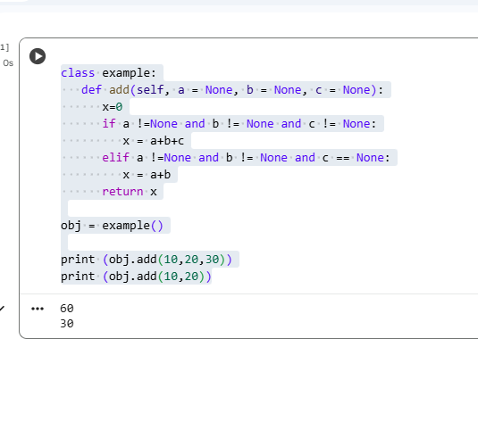

Slide 9


